Slide 1
PicoQuic Cyber Attack
Ruaa Miari & Majd Hamdan
Final Presentation

Slide 2


Agenda
Project Overview
Project Objectives
QUIC Protocol Overview
Key Features Of QUIC
Security Analysis Of QUIC
Known Attacks On QUIC
Explaining The Details Of Our Attack
detecting a picoquic implementation issue
A

Slide 3
Project Overview
The QUIC protocol is a secure and efficient transport protocol designed for handling multiple data streams with low latency.
Its primary goal is to enhance the performance of HTTPS traffic. It has gained recognition by being standardized as RFC 9000, suggesting it could become the dominant internet transport protocol.
On this presentation we will analyzing QUIC with a focus on it’s cybersecurity aspects.

Slide 4
Project Objectives
Investigate the ability of the QUIC protocol to withstand cyber attacks by implementing known attack on QUIC.
Learning
To get acquainted with QUIC protocol and its fundamental features.
Examining
To delve deeper into the security aspects of QUIC and examine how secure it really is.
Implementation

Slide 5
Project Evolution: Our Ongoing Progress

Slide 6
1) Establishment a foundational understanding of the QUIC protocol through extensive reading of numerous articles and RFCs related to QUIC.

Slide 7
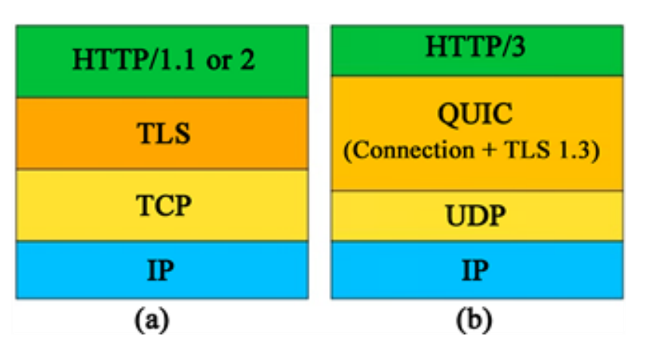
QUIC Protocol Overview
QUIC (Quick UDP Internet Connections) is newly proposed secure transport protocol.
it is built on top of UDP and includes encryption by default that uses TLS 1.3 for securing its payload.
QUIC enhances various aspects over TCP, including faster connection establishment.
QUIC provides a low latency, and overcomes many issues
found in the current transport protocols, such as the high-latency
connection establishment in TCP.

Slide 8
Key Features Of QUIC
Multiplexing.
Authenticated and Encrypted Packets.
Low latency.
Reduced Handshake Latency.
Fast Connection Establishment.
Connection Migration.

Slide 9
2) Gaining knowledge with well-known cyberattacks, specifically those targeted at the QUIC protocol.

Slide 10
Security Analysis Of QUIC
According to this article” Revisiting QUIC attacks: a comprehensive review on QUIC security and a hands-on study” ,despite its robust security architecture, QUIC is not impervious to vulnerabilities and potential attacks. In this section, our primary focus will be directed towards comprehending the various attacks that was carried out to the QUIC protocol.

Slide 11
Known Attacks On QUIC
QUIC Flood DDoS Attack.
QUIC Amplification Attack.
Optimistic Ack Attack.
Slowloris Attacks.
Peer Denial Of Service.
Traffic Analysis.
Source Address Token Replay Attack (the one we tried to implement).

Slide 12
3) Choosing one of these attack ( stk replay attack ) to implement on one of the open-source QUIC implementations.

Slide 13
4) Reading more about stk replay attack and choosing picoquic as an implementation to do the attack on.

Slide 14
address validation token
A server MAY provide clients with an address validation token during one connection that can be used on a subsequent connection. Address validation is especially important with 0-RTT because a server potentially sends a significant amount of data to a client in response to 0-RTT data.
The server uses the NEW_TOKEN frame to provide the client with an address validation token that can be used to validate future connections. In a future connection, the client includes this token in Initial packets to provide address validation.

Slide 15
address validation token
An address validation token MUST be difficult to guess.
There is no need for a single well-defined format for the token because the server that generates the token also consumes it.
When a server receives an Initial packet with an address validation token, it MUST attempt to validate the token, unless it has already completed address validation. If the token is invalid, then the server SHOULD proceed as if the client did not have a validated address,

Slide 16
An attacker can replay the source-address token stk of a client to the server that issued that token on behalf of the client many times to establish additional connections. This action would cause the server to establish initial keys and even final forward-secure keys for each connection without the client's knowledge. Any further steps in the handshake would fail, but an adversary could create a DoS attack on the server by creating many connections on behalf of a many different clients and possibly exhausting the server's computational and memory resources.

Slide 17
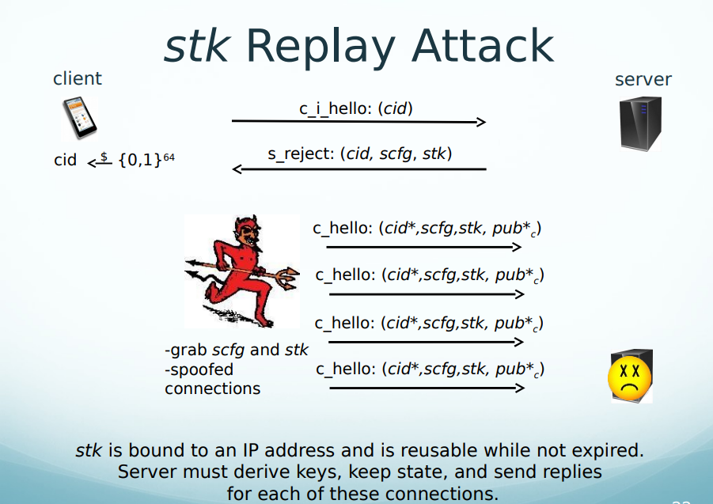

Slide 18
5) Going deeply in picoquic sample code of client-server model.

Slide 19
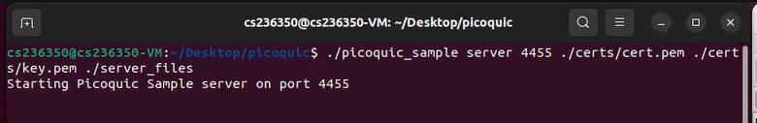
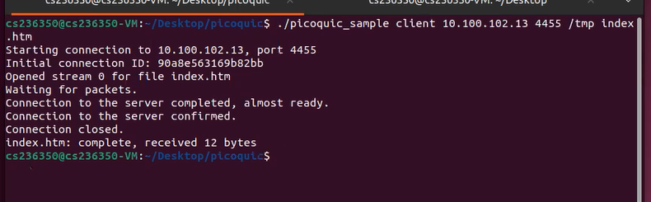

Slide 20
Live Demo for client sever model in picoquic.

Slide 21
7) The attack is not possible in picoquic.

Slide 22
After more searches in the PicoQuic implementation we found that in every connection between the client and server, the server sends a packet with NEW_TOKEN field. This field contains the Token that the client should use in the next connection. And that means that the assumption on the server we mentioned before (The token is valid not only for a single use, it could be used multiple times) doesn’t held. And the Picoquic is not vulnerable to the Source Address Replay Attack

Slide 23
How does the RFC 9000 refer to that issue
From the RFC 9000:
Attackers could replay tokens to use servers as amplifiers in DDoS attacks. To protect against such attacks, servers MUST ensure that replay of tokens is prevented or limited. Servers SHOULD ensure that tokens sent in Retry packets are only accepted for a short time, as they are returned immediately by clients. Tokens that are provided in NEW_TOKEN frames need to be valid for longer but SHOULD NOT be accepted multiple times. Servers are encouraged to allow tokens to be used only once, if possible; tokens MAY include additional information about clients to further narrow applicability or reuse.
The RFC 9000 clarify that the Token should not be accepted multiple Time.

Slide 24
Additional attempts to implement the attack

Slide 25
1) Checking out an older version of the picoquic protocol.
The first commit of the picoquic was in 2017.
But this version was the first steps of the implementations and it didn’t contain a Cmake or samples to run.
So we tried newer versions, and we got so many errors in the cmake because the picoquic uses the picotls, so we needed to checkout also old versions of picotls and run the whole process of cmake and running samples from the beginning, as mentioned in the readme in the old version.
After so much work the oldest version we could run was in 2018, and it was not vulnerable to this attack.

Slide 26
2) Running an old implementation called gQuic (its not the google quic the name is misleading).
This implementation started in 2018 and also the last version of it was in 2018.
After cloning and running the demo of the implementation we found that this implementation was not complete, the Wireshark shows the packets as UDP and not Quic, and when trying to change the configuration of the packet to Quic, the Wireshark was popping an error massage that the packet is not in Quic format, also there was no encryption of the packets and there was no implementation of a client and server in the implementation.
So it was not possible to work with this implementation

Slide 27
3) Running the aioquic
After running this implementation we found that it doesn’t contain token support, when trying to send initial packet the server always askes for the full handshake process.
So it was not possible to implement the attack on this implementation either.

Slide 28
More attempts
The Quic protocol is relatively new, so most of the implementation started after 2018 and implements new versions of the RFC 9000.
https://github.com/quicwg/base-drafts/wiki/Implementations
This link list the implementations of IETF Quic and the versions it supports, we can see that all the implementations supports draft 27 of the RFC 9000, that was published in Feb 2020 and newer.
So also attempts to implement the attack on old versions did not succeed.

Slide 29
Last attempt: change the code of the picoquic to make it vulnerable to the attack and then implement it.

Slide 30
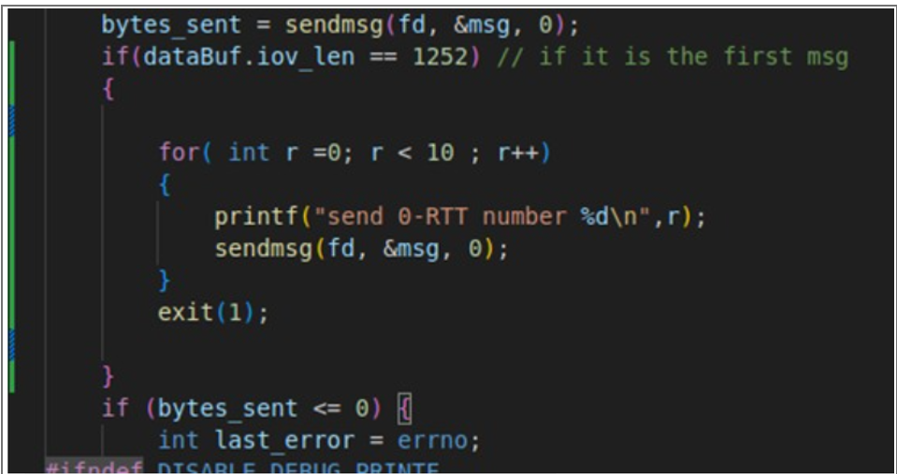
Send replayed 0-rtt packets from client side and track it from the server side.

Slide 31
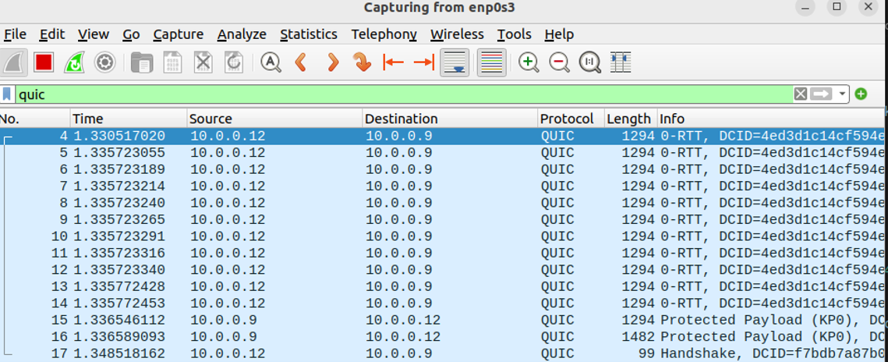
The server responds only to the first legitime 0-RTT request.

Slide 32
Detecting a picoquic implementation issue

Slide 33
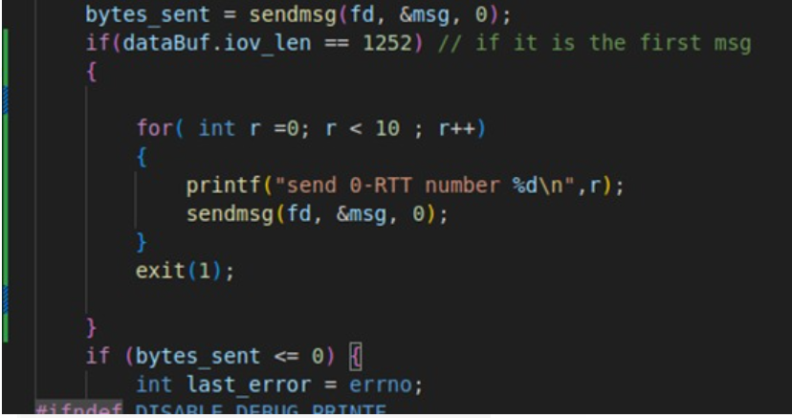
change the client code to send the 0-RTT packet again
We didn’t see any special behavior, so we tried to re-send the message more than twice , we send it 1 Million times !
we detect a strange behavior ! the server respond with payload packets each (about) 700,000 0-RTT requests.

Slide 34
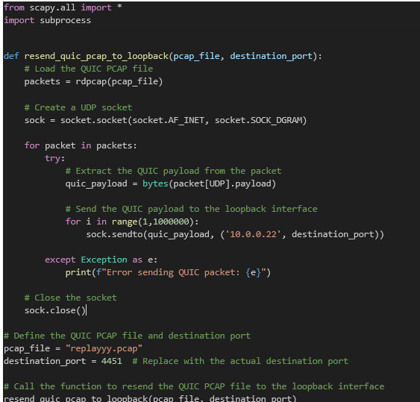
Writing a script that capture a 0-RTT packet that a legitimate client sends, and resends it via a new socket 1 Million times

Slide 35
Demo for resending 0-RTT packets using the script.

Slide 36
Digging into the issue and answering some questions

Slide 37
What are the Initial and Handshake packets we saw in the demo?
When the attacker send the first 0-RTT, the server respond with the protected payload, then the server expect from the client to finish the connection by sending CC frame ( connection close), but because the attacker sends only the 0-RTT messages, the server will try to restore the connection with the client by sending initial and handshake packets to re-establish the connection.

Slide 38
What is the accurate number of replayed packets that cause the server to respond in the second weakness ?
After many attempts to try to find the specific number or even approximation to the number of packets we need to send in order to make the server respond.
Each time we got a different number of packets.
So…
Is it a timing issue?

Slide 39
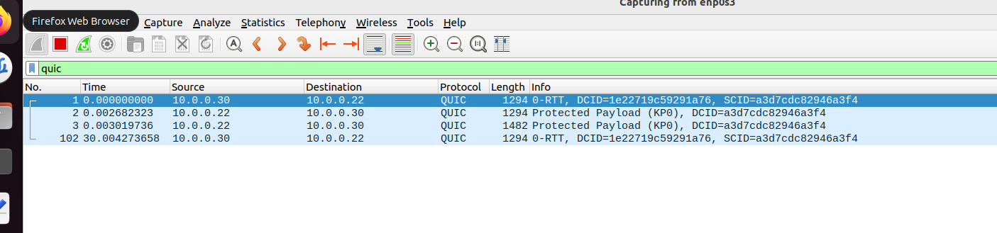
What if this occur because of timeout and not because of the number of packets that the attacker send ?
Let’s check:
First try:
We added sleep(30) after sending the first 0-RTT message, then we send the second 0-RTT ( we send only two 0-RTT ) .
Result :
The server only responded to the first 0-RTT packet and completely
ignored the second replay.

Slide 40
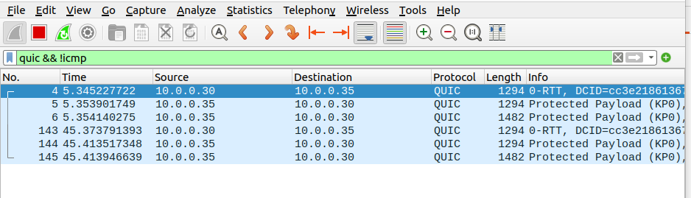
Second try:
Lets try to sleep(40):
So it’s a timing issue!!!

Slide 41
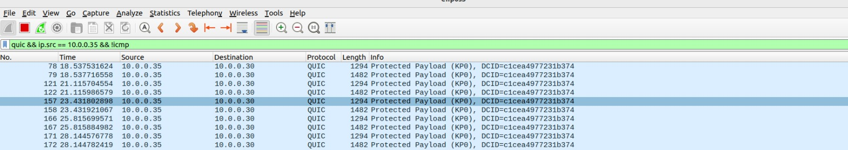
In the Demo, we disconnected the client side from the internet, in order to capture the 0-RTT packet, and not allowing it to be received in the server side.
Is it necessary for the attack success ?
After running the same steps of the attack but without disconnecting the client side from the internet,
we got the same results, which means that this step is not relevant to the attack implementation.
Output:

Slide 42
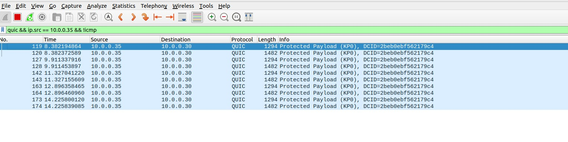
Is these weaknesses related to sockets?
What if we tried to send the same massage from different sockets at the same time
The attacker’s script we wrote, create one socket, and send one message over it.
Let’s try to send the 0-RTT packet 5 times, each time from a new socket and see how the server respond.
We changed the script accordingly
Result:
The server is responding to all the replays !!

Slide 43
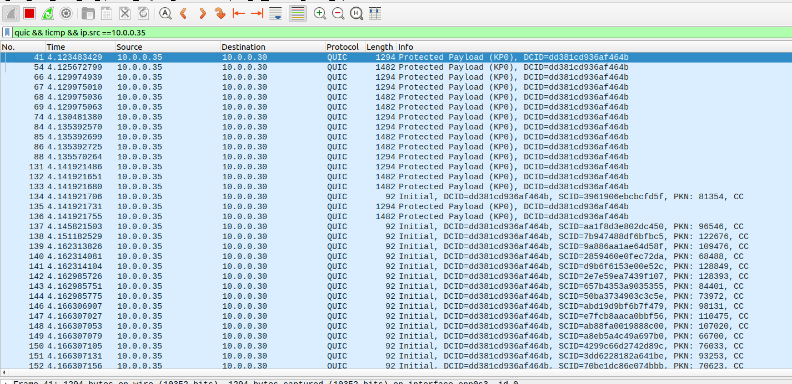
Lets try to open 100 sockets and send the replayed packet over each one.

Slide 44
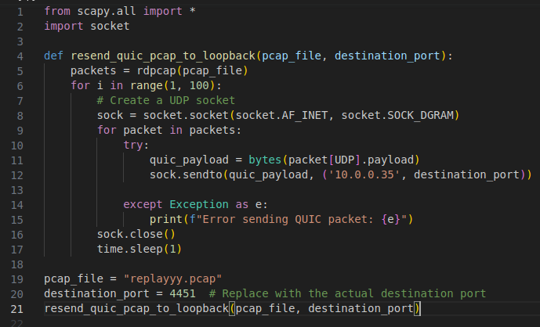
Is this also a timing issue?
Let’s wait 1 second between opening the sockets :

Slide 45
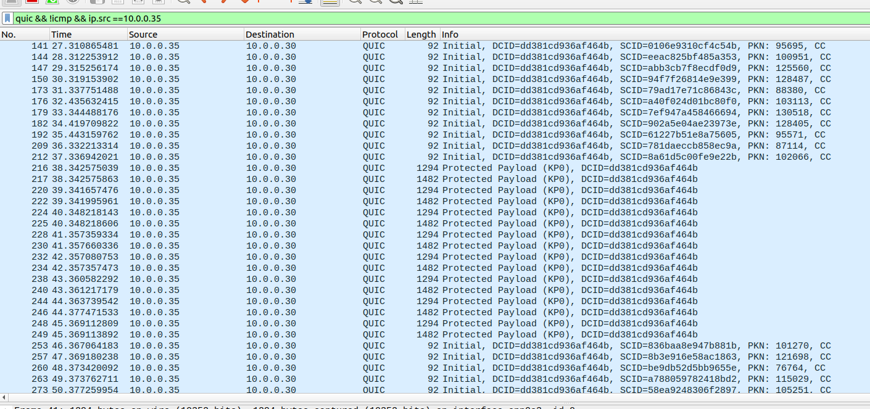
Result :

Slide 46
Why the server drops the packets that are received immediately after the first 0-RTT packet?
These packets are recognized as “already” received packets in picoquic_is_pn_already_received function, this function checks if the packet number has received before ( to manage the acknowledgment mechanism) , and because we are replaying the same packet (with same packet number ) the server recognize it as a transmitted packet so it ignores them.
This check has a timeout of ~ 40 seconds.
All the packets that the server received in this period of time are dropped.

Slide 47
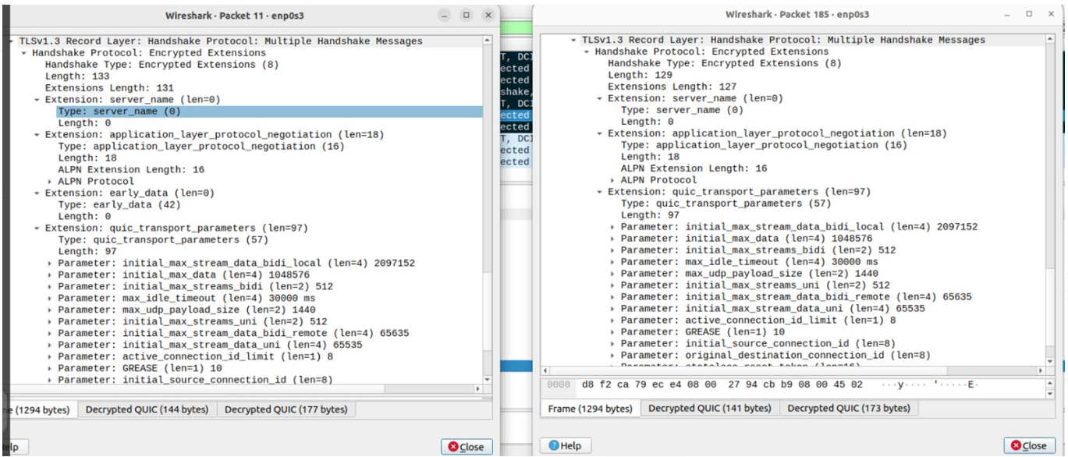
Does the server validate the replayed address token?
To trying answer this question, we will compare the handshake packet that the client receives from the server in a legitime connection with the handshake packet we receive as a response on the replayed 0-RTT.
Looks same structure !

Slide 48
Can we surely say that the address token validation is done by the server?
to answer this question we searched into the server code for the specific function that process the initial packet, and determine if the client address is validated or not. we found a function called picoquic_incoming_client_initial:
and the section that checks if the server validated is:

Slide 49
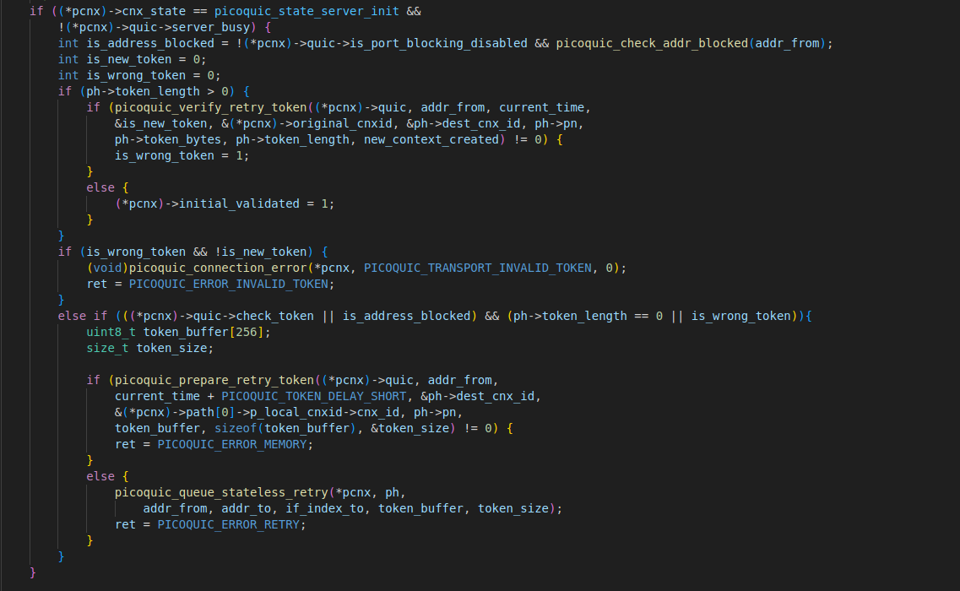

Slide 50
In the code there is the if statement that checks the token and if it is validated it sets the initial_validated variable to 1 else it sets the variable is_wrong_token to 1.
After debugging the code with printfs, we saw that when the server recieves a replayed 0-RTT packet, the is_wrong_token variable is set to 1 !! but the server doesn’t do anything with it, because non of the error checks is taken.
Due to another conditions in the if statement.

Slide 51
So is it possible to cause a DOS to the server by replaying the first 0-RTT packet?
The answer of this question is complicated because from one side, the server is validating the client address after the replayed 0-RTT packet. but on the other side the server only takes a 0-RTT packet each 40 seconds.
Maybe if we can take multiple 0-RTT packets from different clients and repeat it from different source addresses the Dos attack will be possible as explained before.

Slide 52
future work
This project sets all the work necessary to run and work with picoquic, the Quic protocol have so many details and features, and the picoquic implements these features.
Future work can be done to test other attacks known on the Quic protocol and maybe try to find new ones, either on the picoquic or any other implementation.

Slide 53
What We Learned from the Project
To grasp the fundamentals and significantly expand our knowledge of the QUIC protocol, which we had no prior familiarity with.
To effectively communicate with partners. We learn from each other, and expand our knowledge and skills. Partnering with someone brings diverse viewpoints to the project, leading to more innovative solutions.
To know the importance of thorough planning from the outset. This project has shown us that when start working on any task, it's crucial to delve deep into the details to gain a comprehensive understanding. Every detail during this process has provided valuable insights, enabling us to make informed decisions and facilitating our overall progress.

Slide 54
To NOT jump to quickly to conclusions. Instead, we should persistently attempt to find out new results and analyze it and seek explanations for what we observe.
To ask for help when we're facing a challenge or feeling stuck.
To not give up, specifically when we analyze the security side of QUIC and tried to implement the attack, we had a several failing attempts that made us feeling frustrated, but keeping trying led us to this final work.

Slide 55
We would like to extend our heartfelt gratitude to Eran Tavor and Alon Danker for their guidance, support, and invaluable knowledge throughout this course.
Your dedication to our progress in this project has been truly inspiring.
Thank you for being an exceptional moderator.

Slide 56
10. References
1.https://datatracker.ietf.org/doc/rfc9000/
2. https://link.springer.com/article/10.1007/s10207-022-00630-6
3. https://ieeexplore.ieee.org/document/7163028
4. https://github.com/private-octopus/picoquic/tree/master
5. https://www.net.in.tum.de/fileadmin/TUM/NET/NET-2022-07-1/NET-2022-07-1_10.pdf

Slide 57
Thank you
Presented by :
Ruaa & Majd​
ruaa.miari@campus.technion.ac.il
majd.hamdan@campus.technion.ac.il

